Slide 1
Data Scraping from Google Play Store , Visualization of its Content’s and Analysis on App Permissions
Project Guide : Dr. Sabitha S Geo Thomas
LTVE18MCA065

Slide 2
Literature Review
Playstore Dataset creation
Exploratory data analysis
Analysis on App permission

Slide 3





Implementation

Slide 4


Cont..
Developer ID
Developer Page
App ID

Slide 5

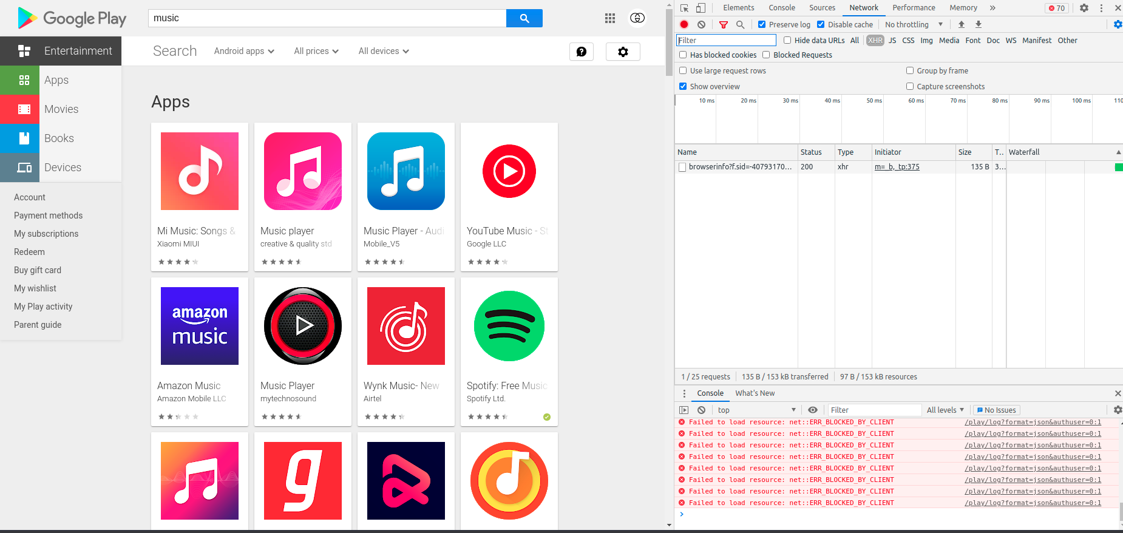
Headless Browser

Slide 6
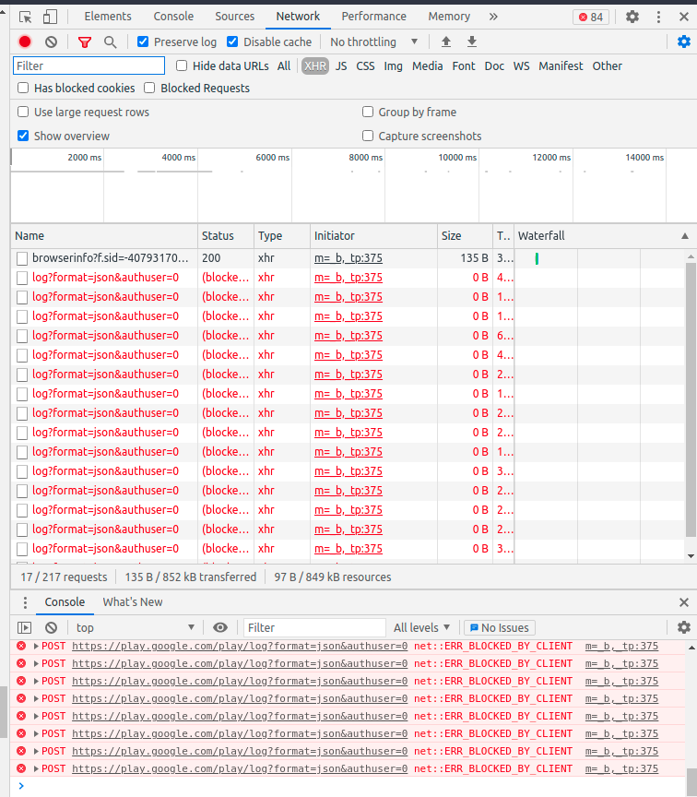
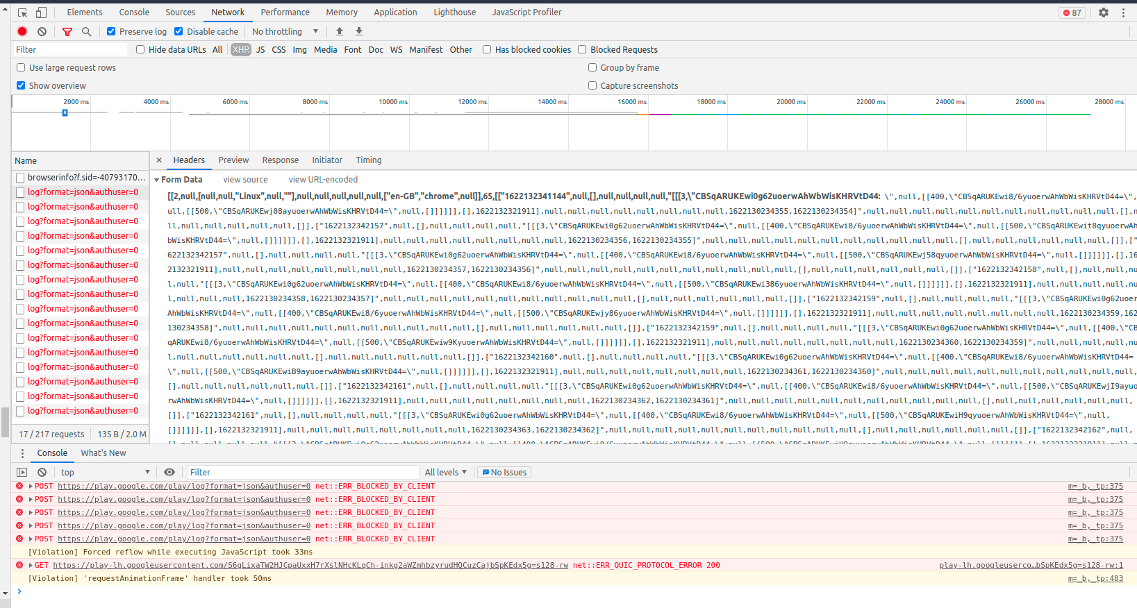
Cont..

